Slide 1
Database Management Class Project
Wilson Rey, Ben Weeks

Slide 2
Description
Our “Retail Management System” is designed to help an owner of a retail business keep track of their business’s customers, employees, vendors.
The system allows employees to determine which items are selling the best, how often customers shop, and know what inventory is available across all locations.

Slide 3
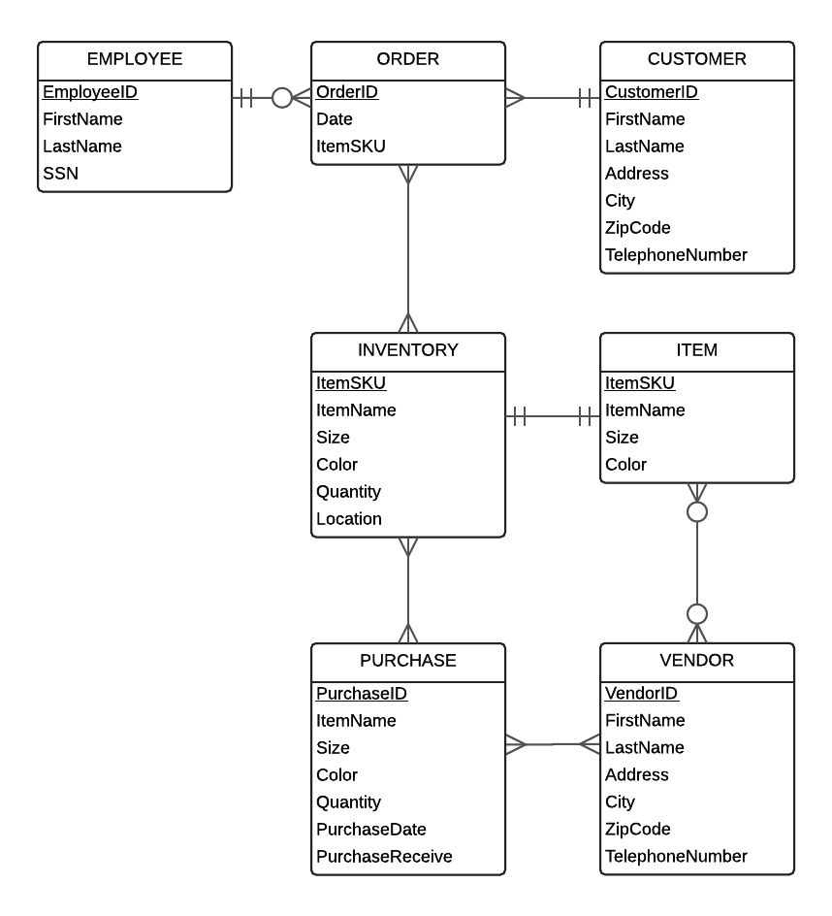
ERD Diagram
Seven tables in total:
EMPLOYEE – Information about an employee.
ORDER – Orders placed by a customer.
CUSTOMER – Information about a customer.
ITEM – An item that has been sold at one point.
INVENTORY – The amount of stock available for sale.
VENDOR – A company through which more inventory is acquired.
PURCHASE – A purchase made to a vendor for more inventory.

Slide 4
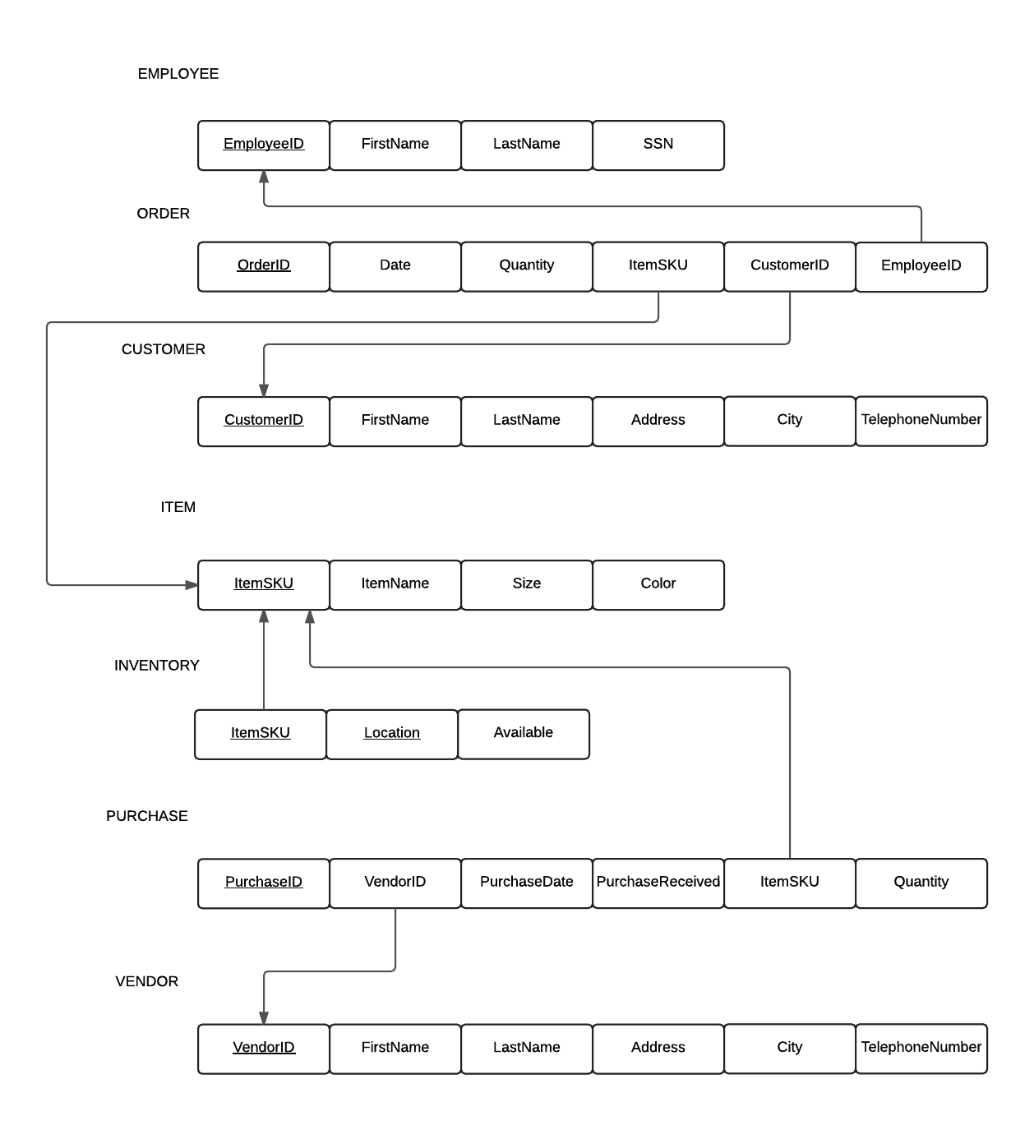
Logical Design
Several foreign keys.
The order table wins for most foreign keys needed. It drew from customer, employee, and item.
Purchase only had two foreign keys.
Inventory only had one foreign key.

Slide 5
SQL Scripts/Physical Design
CREATE TABLE "EMPLOYEE" (
"EmployeeID" number primary key,
"FirstName" varchar2(25),
"LastName" varchar2(25),
"SSN" varchar2(11));
CREATE TABLE "CUSTOMER" (
"CustomerID" varchar2(6) primary key,
"FirstName" varchar2(25),
"LastName" varchar2(25),
"Address" varc har2(40),
"City" varchar2(25),
"ZipCode" varchar2(9),
"TelephoneNumber" varchar2(13));
Lessons Learned
CamelCase on columns is a bad idea.
Not a show stopper, just made queries picky about escaping them in “double quotes”.
ORDER is a reserved word.
Don’t name your tables after reserved words like “SELECT” unless you want to escape it in every instance.
Create simple tables first.
You can’t make references if the originating table does not exist.
Hyphens take up space.
We made assumptions about the data before looking at it.
Try importing mock data early.

Slide 6
Stored Procedure
SQL> execute top_items();
The item "ipsum aliquam non" has been purchased 476 times.
The item "sit amet" has been purchased 442 times.
The item "quis tortor" has been purchased 415 times.
The item "duis" has been purchased 410 times.
...
...
...
The item "arcu" has been purchased 206 times.
The item "aenean fermentum donec ut" has been purchased 199 times.
The item "vestibulum sagittis" has been purchased 197 times.
The item "at lorem integer tincidunt" has been purchased 174 times.
PL/SQL procedure successfully completed.
SQL>
CREATE OR REPLACE PROCEDURE top_items AS
CURSOR top_item IS
SELECT "ITEM"."ItemName" AS "Name", "ORDER"."ItemSKU" AS "SKU", SUM("ORDER"."Quantity") AS "Quantity"
FROM "ORDER" INNER JOIN "ITEM" ON "ITEM"."ItemSKU" = "ORDER"."ItemSKU" WHERE "ORDER"."Date" > SYSDATE - 365
GROUP BY "ORDER"."ItemSKU", "ITEM"."ItemName" ORDER BY "Quantity" DESC;
top_item_row top_item%ROWTYPE;
BEGIN
OPEN top_item;
LOOP
FETCH top_item INTO top_item_row;
EXIT WHEN top_item%NOTFOUND;
DBMS_OUTPUT.PUT_LINE('The item "'||top_item_row."Name"||
'" has been purchased '||top_item_row."Quantity" ||' times.');
END LOOP;
CLOSE top_item;
END;

Slide 7
Questions?

